Slide 1


Sequential
FR
FABRIKAM RESIDENCES
Jeremy Vijay Wongso - 109711007
Kholishotul Amaliah - 109711008
Bastian Farandy - 109711009

Slide 2
Dataset
The dataset that we use is a top 10 cancer type article dataset downloaded from PubMed.
We take a sample of 1000 records of data for each cancer type category.
Each record of data contains some features such as PUMID, Title, Abstract, Content, Cancer Type.
Content is the concatenation of title and abstract.
We only take the content from each of the record, and then we normalize the content so that it can be used for text classification purpose.

Slide 3
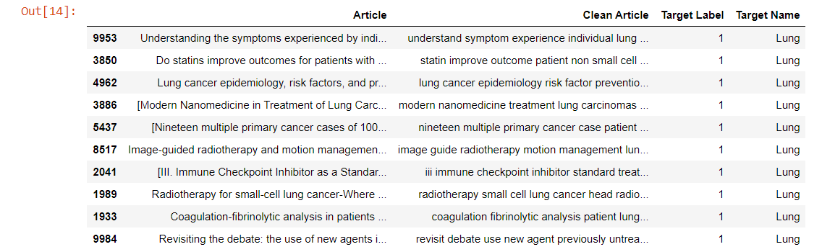
Clean Articles

Slide 4
TF (Term Frequency)
We split the processed data into 2 sets, which are training set and test set. With ratio 0.67 for the training set and 0.33 for the test set.
Then, we extract the feature of the training set and the test set of the data using the Count Vectorizer from sklearn library. So that we can use those sets of data to build a classification model.
The classifications model that we use are:
  Naive Bayes
  Logistic Regression
  Linear SVM
  SGD
  Random Forest
  Gradient Boosted Machine

Slide 5
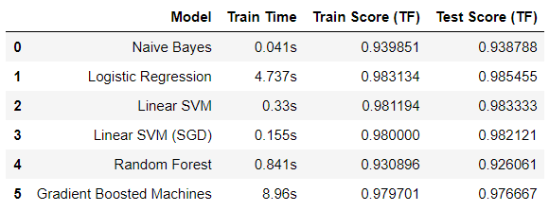
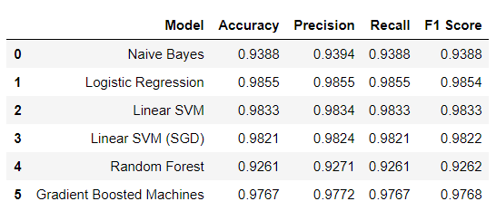
TF Classification Model Comparison

Slide 6
TFIDF (term frequency–inverse document frequency)
We split the processed data into 2 sets, which are training set and test set. With ratio 67% for the training set and 33% for the test set.
Then, we extract the feature of the training set and the test set of the data using the TfidfVectorizer from sklearn library. So that we can use those sets of data to build a classification model.
The classifications model that we use are:
  Naive Bayes
  Logistic Regression
  Linear SVM
  SGD
  Random Forest
  Gradient Boosted Machine

Slide 7
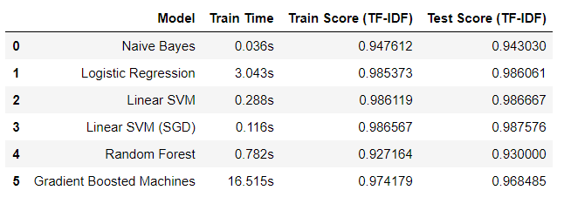
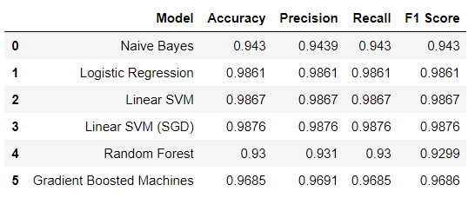
TFIDF Classification Model Comparison

Slide 8
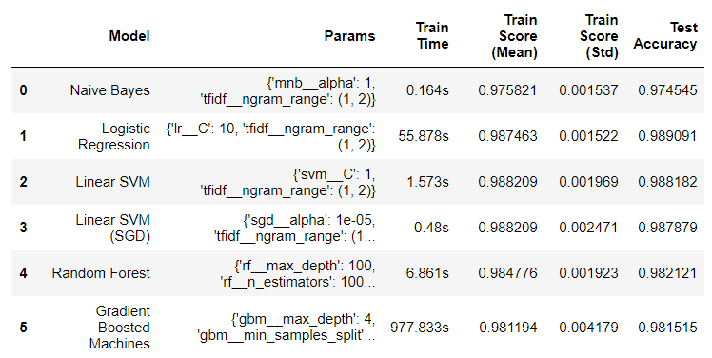
TF-IDF : Performance Comparison (Accuracy)
Without Hyperparameter Tuning
With Hyperparameter Tuning

Slide 9
TFIDF: Optimizing Hyperparameter
Grid Search

Slide 10
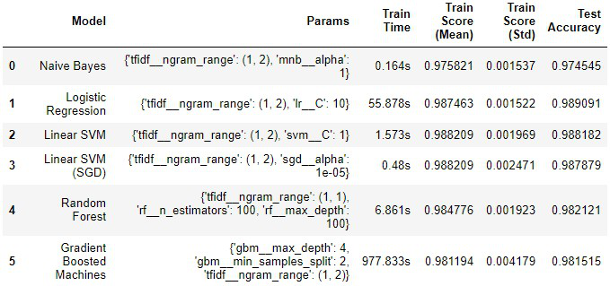
TFIDF: Optimizing Hyperparameter
Random Search

Slide 11
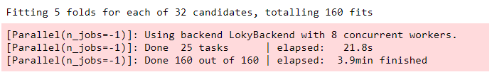
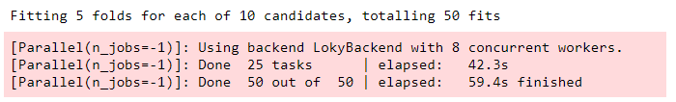
TF-IDF : Performance Comparison (Time)
Random Forest - Using Grid Search CV
Random Forest - Using Random Search CV

Slide 12
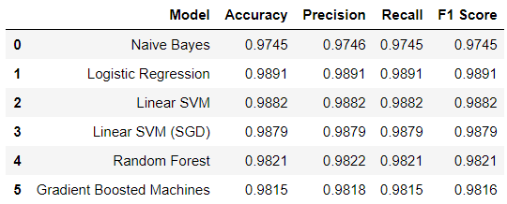
TF-IDF Hypertuned : Performance Score

Slide 13
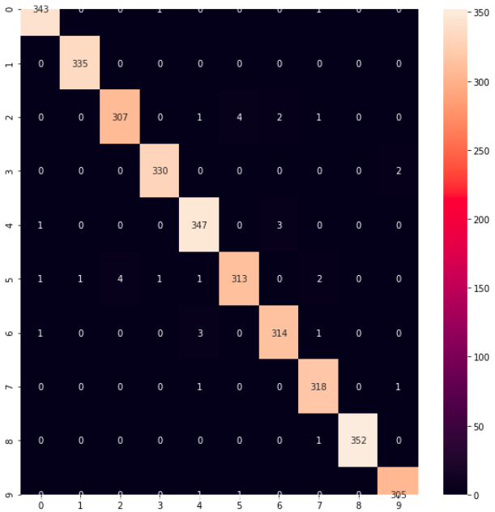
TF-IDF : Confusion Matrix of The Best Model

Slide 14
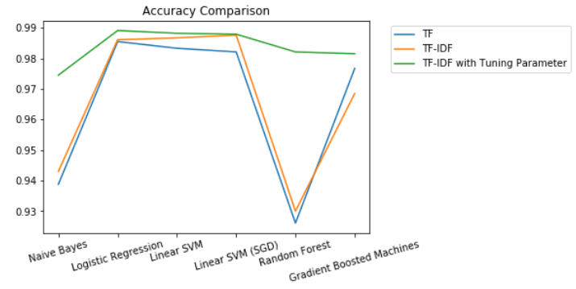
Accuracy Comparison

Slide 15
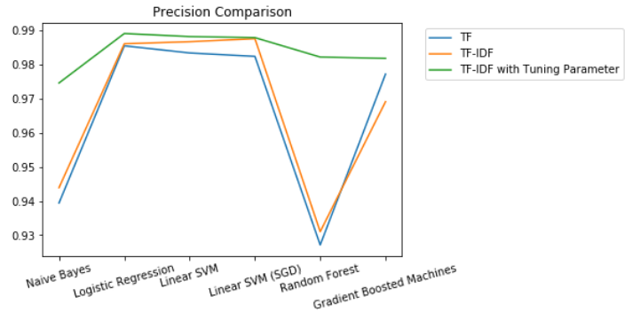
Precision Comparison

Slide 16
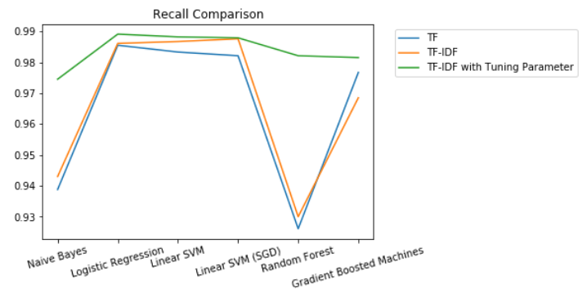
Recall Comparison

Slide 17
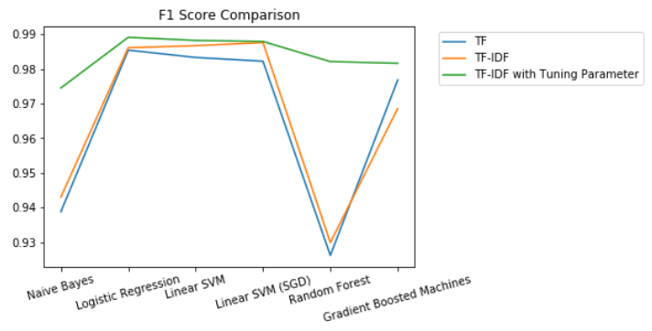
F1 Score Comparison

Slide 18
Conclusion
We can conclude that TF-IDF has better performance than TF has because the TF-IDF model contains information on the more important words and the less important ones as well, while the Bag of Words just creates a set of vectors containing the count of word occurrences in the document (reviews).

Slide 19
Conclusion
Performance Comparison
When hyperparameter tuning is involved, the models give a better performance, in terms of accuracy. This happened because the models are using the optimal parameters.
Time Comparison
Random search perform more efficiently(in time) while giving the same accuracy as Grid Search. This happened because random search finds optimal parameter by randomly choose a parameter.

Slide 20
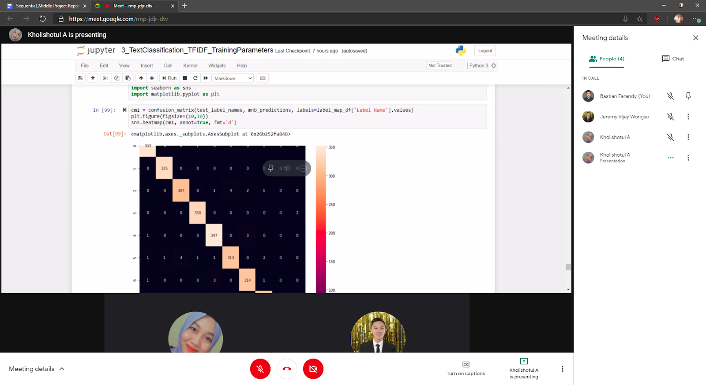
Group Meeting

Slide 21

Thank you
FR
FABRIKAM RESIDENCES
Sequential

